Slide 1
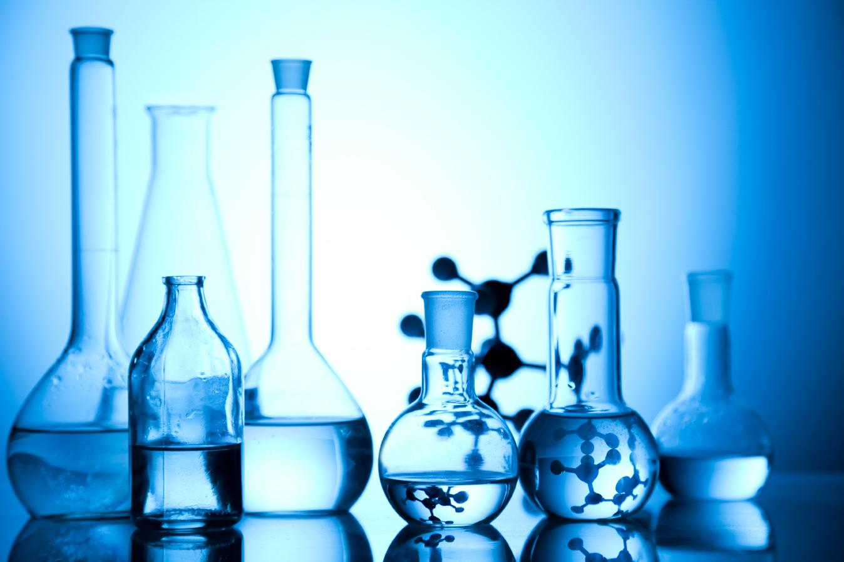

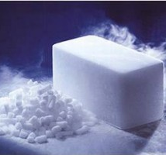
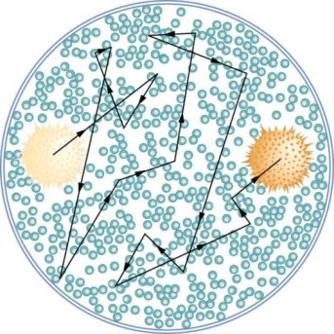
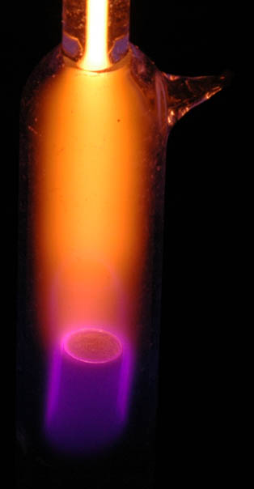
MATTER IN OUR SURROUNDINGS

Slide 2

MODULE : 1
Introduction
Definition of matter

Slide 3
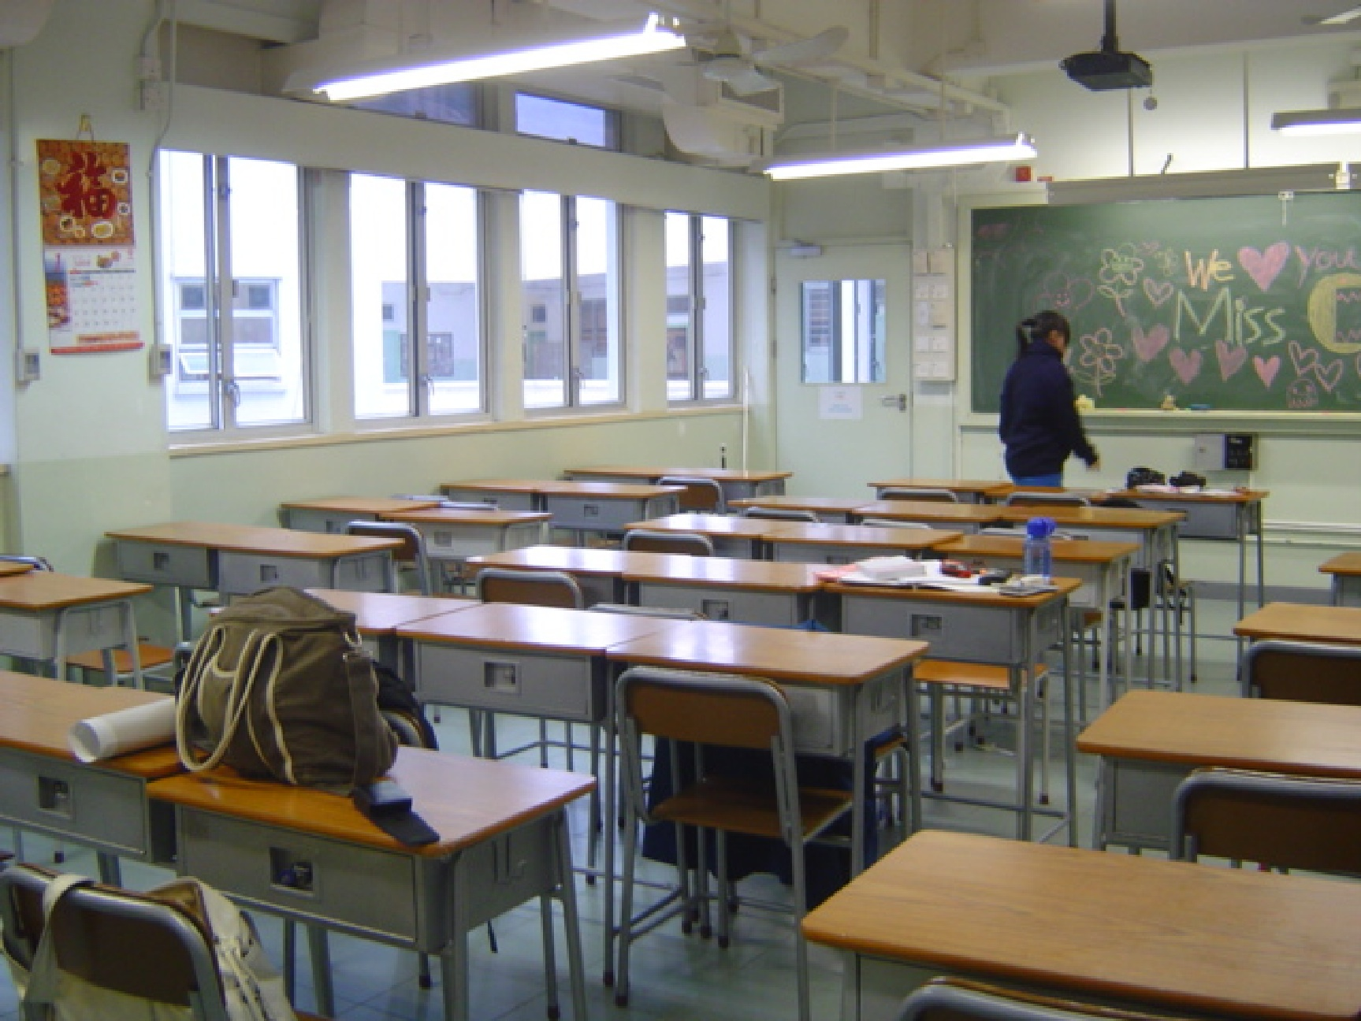
Observe your classroom carefully and
make a list of things that you find
Do all these things have mass ?
Yes, they all have Mass
Do they occupy space ?
Yes, they occupy space
Apart from all these things, something else is also present in the classroom which you cannot see.
What ever present around us is called MATTER

Slide 4
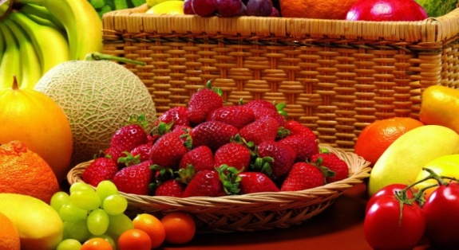
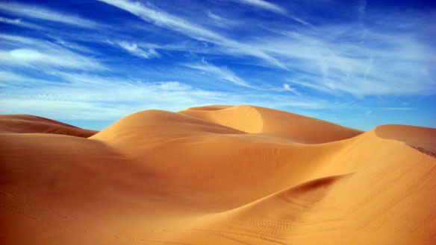

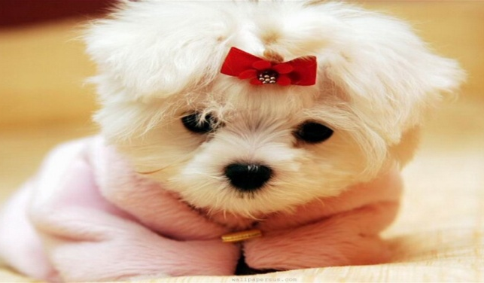
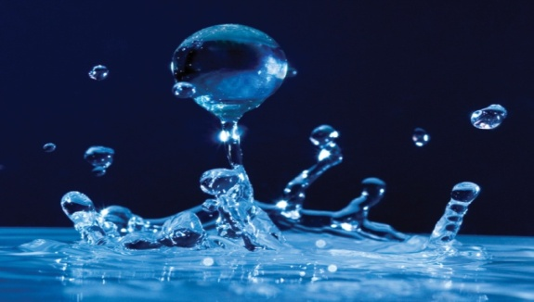

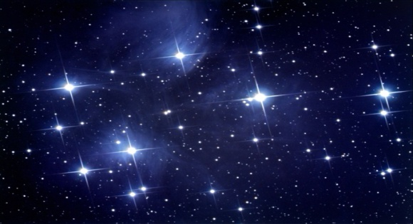
MATTER
Let us see few more examples of matter

Slide 5
MODULE : 2
Classification of matter
Energy, Mass & Volume

Slide 6
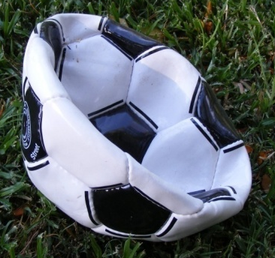

What is matter ?
Anything that has mass and occupies space is called as matter. ‘Which you can perceive through your senses’.
Let’s prove that air has mass
Mass = 1 kg
Mass = 1.5 kg
Mass of football has increased due to air hence
Air has mass and occupies space.

Slide 7
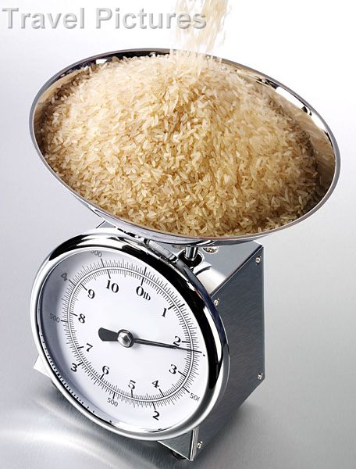
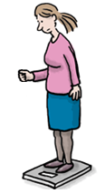
What is mass ?
MASS
: It is a physical quantity which expresses the amount of matter in a body.
What is weight ?
WEIGHT = (Mass × Gravitational acceleration)
Pan weighing
2kg rice
A girl weighing herself on a weighing machine

Slide 8
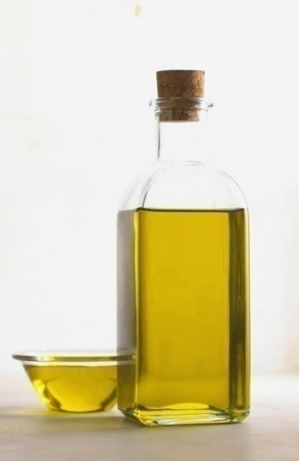
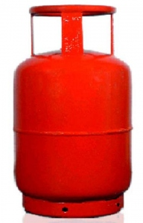
What is volume ?
Amount of gas and oil present in a respective container can be given by another physical quantity called…
VOLUME
: The space inside the container that is occupied by matter is it’s volume.

Slide 9



NOT MATTER !!!
SO….IS EVERYTHING AROUND US MATTER?
HEAT
LIGHT
SOUND
All these are forms of ENERGY

Slide 10
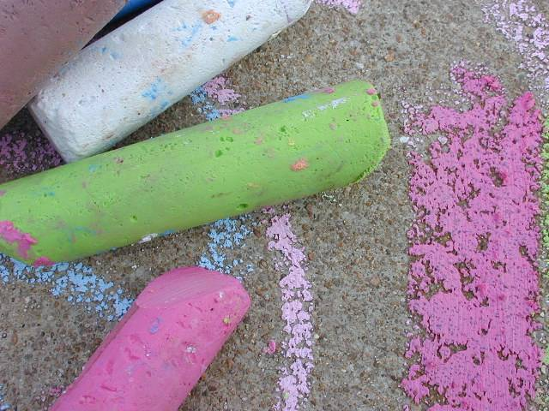
tiny
Matter is made up of tiny particles. The particles which make up matter are atoms or molecules
Matter
particles
atoms or molecules

Slide 11
MODULE : 3
Properties of matter
Property 1 - Matter is made up of small particles

Slide 12
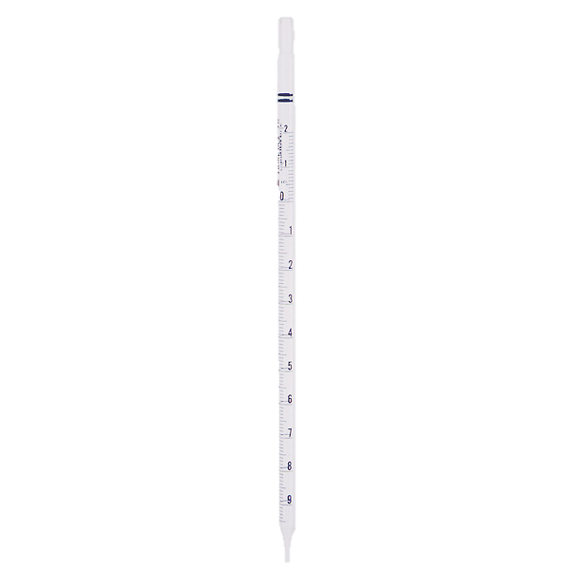
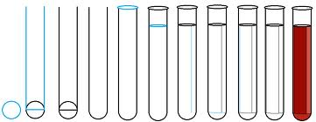

MATTER IS MADE UP OF SMALL PARTICLES
2 or 3 tiny crystals of potassium permanganate can impart color to a large volume of water.
Take 10ml of this solution from and mix it with 90ml of water present in second beaker to dilute it.
Take 100ml water in a beaker
Dissolve few crystals of potassium permanganate
This is because each potassium permanganate crystal is made up of millions of small particles which keep on spreading and imparting color on dilution.
Continue to dilute it for other beakers
A deep purple colour solution is obtained.
The color of the solution becomes still lighter. Why???
This indicates, the particles of matter are very small – they are small beyond our imagination!!!

Slide 13
MODULE : 4
Property 2 – Particles of matter have space between them
Property 3 – Particles of matter are continuously moving

Slide 14
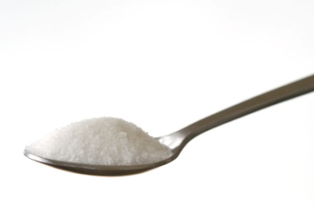

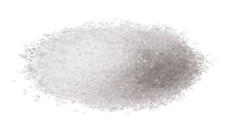
THE PARTICLES OF MATTER HAVE SPACES BETWEEN THEM
This indicates, the particles of matter have spaces between them
Take 100ml water in a beaker
Now, mark the level of water.
Add to this 50g of sugar
Dissolve the sugar by stirring it with a glass rod.
You will notice that the level of water is the same, even after the sugar has been dissolved.
So where does the sugar go ???
Sugar particles get into the spaces between the particles of water.

Slide 15
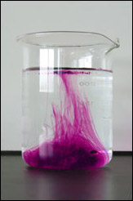
PARTICLES OF MATTER ARE CONTINUOUSLY MOVING
Potassium permanganate particles spread throughout the water particles and mix up on their own without stirring because ‘they are moving’ or they are in motion.
This movement of different particles among each other (on their own), so that they become mixed uniformly, is called diffusion.
This indicates, particles of matter are continuously moving

Slide 16
MODULE : 5
Particles of matter are continuously moving
Brownian motion

Slide 17

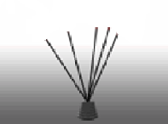


PARTICLES OF MATTER ARE CONTINUOUSLY MOVING
Why are we not able to smell an unlit incense stick from a distance?
What is kinetic energy?
The kinetic energy of an object is the energy which it possesses due to its motion
When we light (or burn) an incense stick in one corner of a room, its fragrance spreads in the whole room quickly.
The particles of gases produced move rapidly in all directions, mix with the moving particles of air in the room.
When lit their kinetic energy increases, the fragrant molecules come in the vapour phase and are diffused in the surroundings

Slide 18
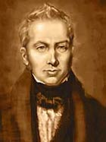
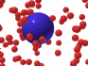
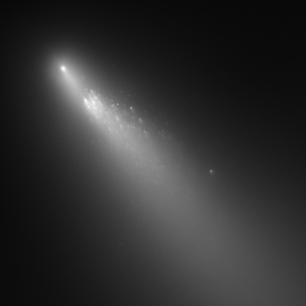

BROWNIAN MOTION
The best evidence for the existence and movement of particles in liquids can be explained by Brownian motion.`
He suspended extremely small pollen grains in water.
When a beam of sunlight enters a room, we can observe tiny dust particles suspended in air which are moving rapidly in a very haphazard way
The zigzag movement of small particles suspended in a liquid (or gas) is called Brownian motion
Under microscope he found that the pollengrains were moving rapidly throughout water in a zigzag way.
Brownian motion increases on increasing the temperature
They move here and there because they are constantly hit by the fast moving particles of air.
Diffusion and Brownian motion are the two processes which
provide the best evidence for the motion of particles in matter.
The pollengrains move on the surface of water because they are constantly being hit by the fast moving particles of water.
Robert Brown [1827]

Slide 19
MODULE : 6
Properties of matter
Diffusion

Slide 20
DIFFUSION
Invert another gas jar
containing air over it
The red brown vapour of bromine
spread out into the upper
gas jar containing air
The upper gas jar which contains
colorless air in it, also turns
red-brown
This mixture is due to the
diffusion of bromine vapour into air.
Air from the upper gas jar also diffuse
into the lower gas jar though
we cannot see it
Diffusion is based on the motion of its particles. Diffusion
is fastest in gases and slowest in solids.
The rate of diffusion increases on increasing the temperature
of the diffusing substances
A gas jar containing
red-brown bromine vapour

Slide 21


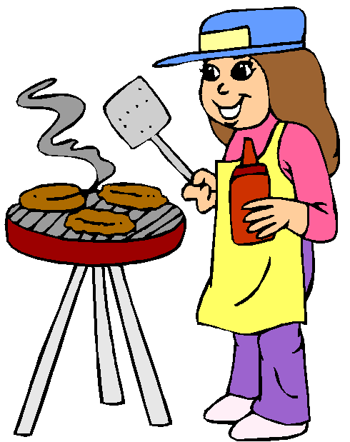




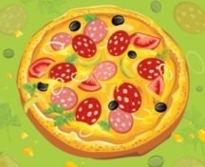
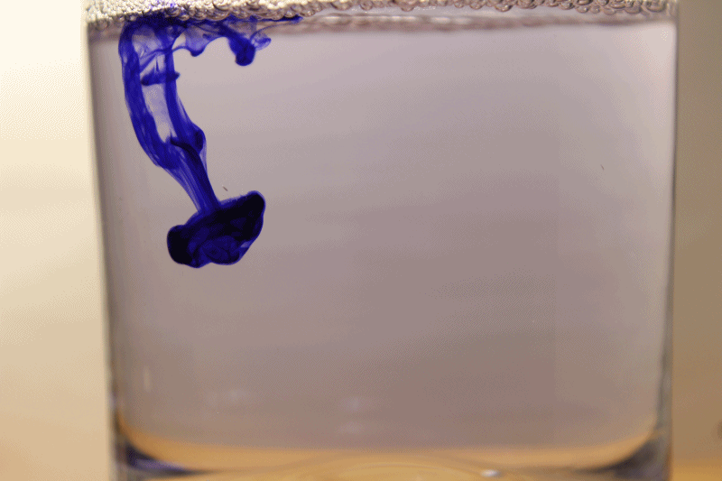
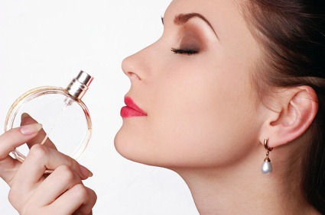






Intermixing of particles of two different types of matter on their own is known as diffusion
Diffusion
The smell of perfume spreads due to the diffusion of perfume vapour into air.
Spreading of ink in water
Diffusion in solids is a very, very slow process.
The smell of food being cooked reaches us even from considerable distance.
The oxygen gas present in air diffuse into water and dissolve in it. The aquatic animals can breathe under water due to the presence of dissolved oxygen.

Slide 22
MODULE : 7
Property 4 – The particles of matter attract each other
Characteristics of matter

Slide 23
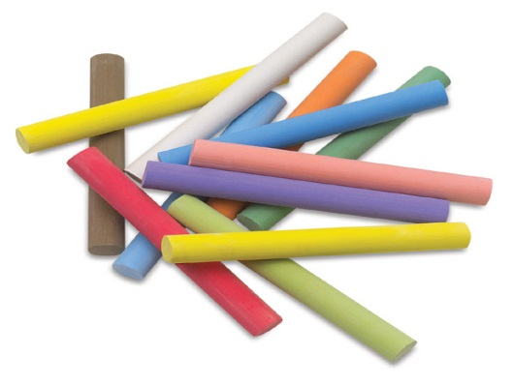
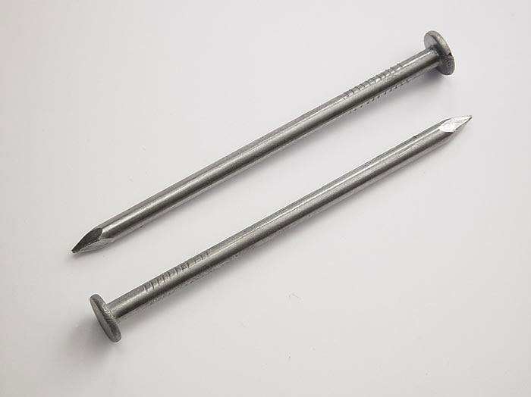
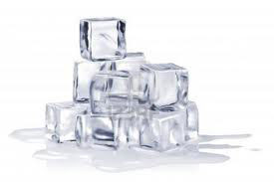
THE PARTICLES OF MATTER ATTRACT EACH OTHER
Chalk
Iron Nail
Ice cube
The force of attraction between the
particles of chalk is quite weak, the
force of attraction between the particles
of ice is a bit stronger whereas the force
of attraction between the particles
of iron nail is very very strong
It easy to break the piece of chalk
into smaller particles,
& a cube of ice requires more force
whereas the iron nail dose not
break even with a large force
The force of attraction is maximum in the particles of solid matter and minimum in the particles of gaseous matter
Take a piece of chalk, an iron nail
and a cube of ice, hit them with hammer
Which is easier to break??
Which requires more force??

Slide 24
Characteristics of particles of matter
The particles of matter are very, very small.
The particles of matter have spaces between them
The particles of matter are constantly moving, as temperature rises particles moves faster.
The particles of matter attract each other.

Slide 25
MODULE : 8
States of matter

Slide 26
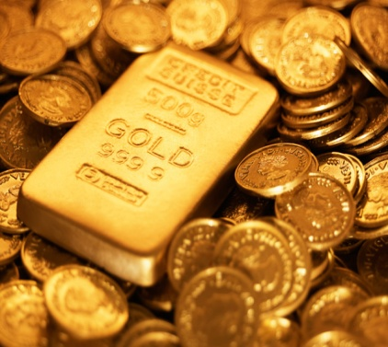
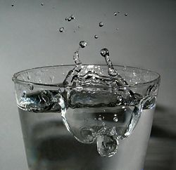
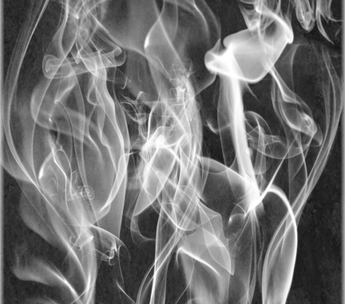
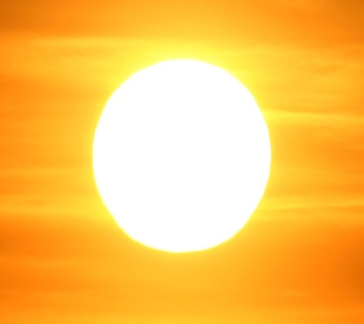
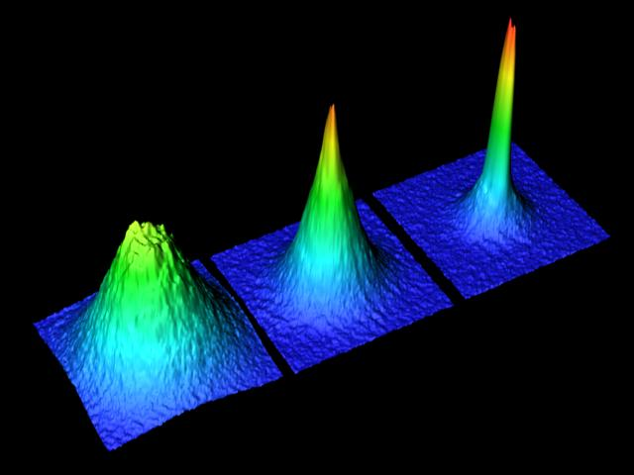
STATES OF MATTER
Matter can even exists in two more
states
Physically matter is classified in to 3 types.
SOLID
LIQUID
GAS
Artificially created state of matter which is at a very low temperature
The matter which is present at a very high temperature like sun
Let’s study solid, liquid and gases in detailed
PLASMA
(Super Hot Gases)
BOSE EINSTEIN
condensate

Slide 27
MODULE : 9
Solid state of matter
Properties of solid state of matter

Slide 28
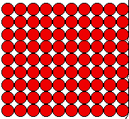

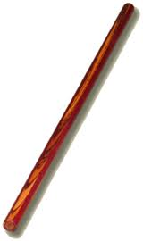

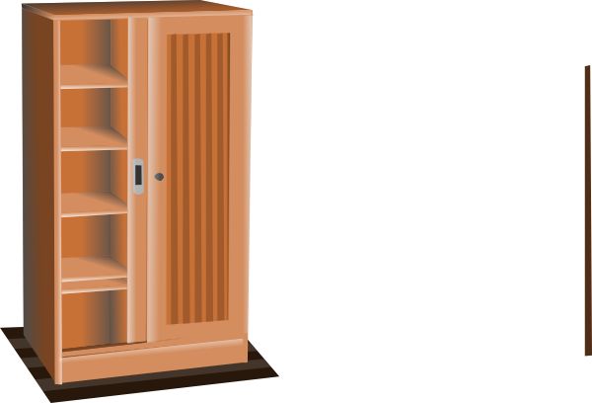


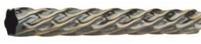
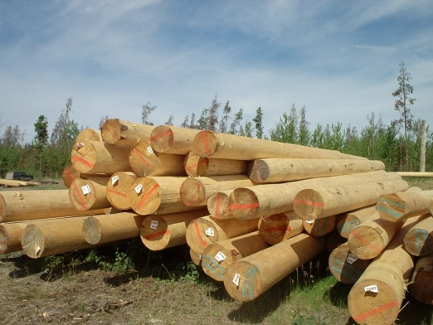
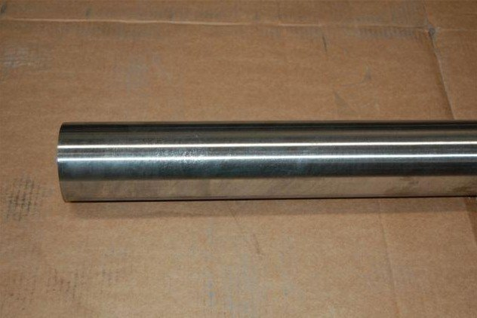
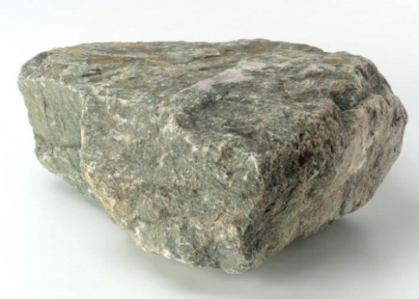
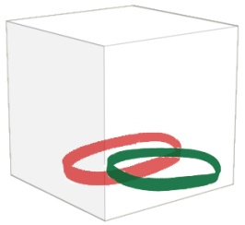
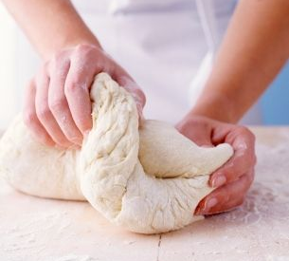
SOLID STATE :
Properties of Solid :
2. Force of attraction between the particles is maximum.
3. The kinetic energy of the particles is least.
1. Space between the particles least
Solids have Definite shape and volume.
Particles of solid are closely packed
together. They cannot move much.
Solids are almost INCOMPRESSIBLE
Structure of solid
Solids are RIGID.
Their volume does not change by any outside force.
Some solids do change their shapes when force is applied and does not regain their shape when force is removed.
Some Solids are ELASTIC.
Their shape does not change by any external force.
Eg. Rubber band
UNBENDING AND INFLEXIBLE.
Some solids do change their shapes when force is applied and regain their shape when force is removed.
Some Solids are PLASTIC.
Negligible compressibility
E.g clay & dough
Definite shape
Distinct boundaries

Slide 29
MODULE : 10
Liquid state of matter
Properties of liquid state of matter
Gaseous state of matter
Properties of gaseous state of matter

Slide 30
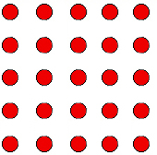
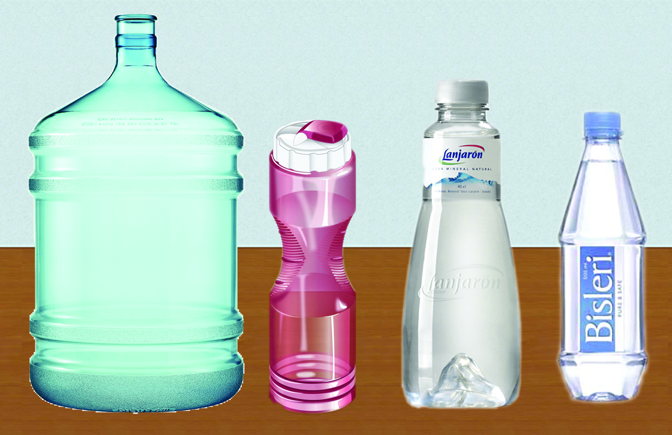
LIQUID STATE :
In liquids, particles have a moderate distance between each other; so particles can move.
2. Force of attraction between the particles is less
3. The kinetic energy of the particles is less.
1. Space between the particles is moderate
Structure of liquid
Properties of liquid :
Liquids have a definite volume. But indefinite shape
Liquids can not be compressed easily.
All liquids flow. The property is called as fluidity

Slide 31
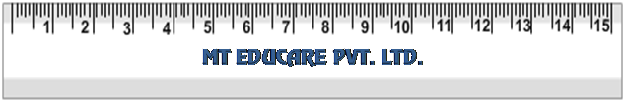
Water
Honey
Milk
Kerosene
Arrange four transparent containers.
Place scale in slanting position.
Allow these liquids to flow down.
Take four different types of liquids.
Milk, honey, kerosene and water.
Less viscous liquid flow easily.
Observe the speed at which they come down
Kerosene comes down first, followed by water, milk, and last honey.
This is due to property of
Viscosity.

Slide 32
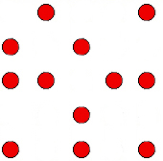




GASEOUS STATE :
Properties of Gases :
Gases do not have definite shape and volume.
Space between the particles is highest
2. Force of attraction between the particles is least.
3. The kinetic energy of the particles is highest.
Gases flow. They show the property of fluidity.
Since gaseous particles have highest space between them, they move freely.
Structure of gas
Smell of delicious pizza can be felt from distance. Due to….
Gases move very fast and can be stopped by the solid walls of container.
Gases can be easily compressed and squeezed together.
Because particles are continuously moving.
Pizzaaaa !!!!!
Soda bottle

Slide 33
MODULE : 11
Distinguish between solid, liquid and gases

Slide 34



Solids, liquids and gases can all diffuse in liquids
Rate of diffusion of liquids are higher than that of solids.
This is because in the liquid state, particles move freely and have greater space between each other as compared to particles in the solid state.

Slide 35

Shape
fixed
not fixed
can very easily flow
Fluidity
can not flow
can flow
not fixed
Compressibility
not compressible
not compressible
compressible
Volume
fixed
fixed
not fixed
Ability to fill the container
Interparticles forces
very strong
moderate
very weak
does not fill the container
does not fill the container
easily fills the container
Density
high
moderate to high
Space between particles
very less
moderate
very low
far apart

Slide 36
MODULE : 12
Change of state
Kinetic theory of matter

Slide 37









CHANGE OF STATE
CHANGE OF STATE
EACH ADDITION OF ENERGY CREATES A CHANGE IN STATE
The phase or state of matter can change when the temperature changes
+ E
+ E
GASES
LIQUIDS
SOLIDS
Ice
Water
Steam
SOLID
LIQUID
GAS
As temperature increases more it turns into steam and particles moves more apart
Particles are very much close to each other as temperature rises
It turns into liquid and particles move away from each other
As temperature (rises)
matter moves to a more active state.
What happens to the particles of matter ?
What happen inside the matter during this change ?
How does this change of state takes place ?
Solid → Liquid
Liquid → Gas
Solid
Liquid
Solid
Gas
The change in state of matter is governed by KINETIC THEORY OF MATTER .
The space between particles.
The force of attraction between the particles.
The kinetic energy of particles (energy of motion).

Slide 38
MODULE : 13
Temperature scale
Conversion of temperature
Numericals based on temperature

Slide 39



TEMPERATURE
Temperature can be measured in 3 scales.
Measure of hotness or coldness of a substance
CELSIUS (ºC)
KELVIN (K)
FAHRENHEIT (ºF)
Common scale
SI Unit
Doctor’s scale
Anders Celsius
Lord William
Thomson Kelvin
Gabriel Daniel Fahrenheit

Slide 40

Kelvin scale
Numerical
Kelvin to Celsius
Convert the temperature of 25⁰C to the Kelvin scale.
K=273+ºC
Temperature at which gas is cooled to obtain zero volume
- absolute zero (0 K)
Such a volume and below are not practically possible to obtain!
Hence, all temperatures are positive.
Convert the temperature of 300 K to the Celsius scale.
Solution :
Solution :
Temp. on Kelvin scale = Temp. on Celsius scale + 273
Temp. on Kelvin scale = Temp. on Celsius scale + 273
= 25 + 273
300= Temp. on Celsius scale + 273
= 298
Temp. on Celsius scale = 300 - 273
Thus, a temperature of 25⁰C on Celsius scale
is equal to 298 K on the Kelvin scale.
= 27⁰C
Thus, a temperature of 300 K to the Kelvin scale
is equal to 27⁰C on the Celsius scale.

Slide 41
MODULE : 14
Inter-conversion of states
Melting
Vaporisation

Slide 42
INTERCONVERSION OF STATES
LIQUID
MELTING (FUSION)
BOILING/EVAPORATION
FREEZING
CONDENSATION
SOLID
SUBLIMATION
GAS
SUBLIMATION

Slide 43


EFFECTS OF CHANGE OF TEMPERATURE
Solid to Liquid : Melting
The process in which a solid substance changes into a liquid on heating, is called melting (or fusion )
The temperature at which a solid substance melts and changes into a liquid at atmospheric pressure is called melting point of a substance .
The melting point of a solid is a measure of the force of attraction between its particles (atom or molecules)
Ice
Water
The melting point of ice is 0°C
The melting point of iron is 1535°C

Slide 44


Liquid to gas : vaporization
vaporization
Boiling
Evaporation
Water
Steam
The process in which a liquid substance changes into a gas rapidly on heating, is called boiling .
The temperature at which a liquid boils and
changes rapidly into a gas at atmospheric pressure,
is called boiling point of the liquid .
Boiling point of water is 100°C .
Boiling point of alcohol is 78°C .

Slide 45
MODULE : 15
Condensation
Freezing

Slide 46




Gas to Liquid : Condensation
The process of changing of a gas (vapour) to a liquid by cooling, is called condensation
Condensation is the reverse of boiling
CONDENSATION
Steam
Water
In this process water vapor formed due to evaporation rises high up the temperature is low, so vapor condenses to liquid and forms clouds.

Slide 47


Liquid to solid : freezing
The process of changing a liquid into a solid by cooling , is called freezing .
Freezing is the reverse of melting .
Water

Slide 48
MODULE : 16
Latent heat of fusion
Latent heat of vaporisation

Slide 49



LATENT HEAT OF FUSION
100
The latent heat of fusion of ice is 3.34×10 ⁵ joules per kilogram.
This heat energy is used up in changing the state of the solid substance by overcoming the force of attraction between` its particles
The heat which is going into ice but not increasing its temperature,
is the energy required to change the state of ice from solid to liquid
(water). This is known as the latent heat of fusion of ice.
As long as there remains even a little of ice in the beaker,
There is no rise in temperature during the melting of ice.
Suspend a thermometer in it
Now heat the ice gently by using a small flame of the burner
Take some crushed ice in a
beaker
This latent heat of fusion (or melting) of a solid is the quantity of heat in joules required to convert 1 kilogram of the solid
(at its melting point) to liquid, without any change in temperature.
Note the temperature of ice
0⁰C
0

Slide 50

Ice at 0⁰C is more effective in cooling
a substance than water at 0⁰C
For melting each kilogram of ice it takes Latent heat of 3.34×10⁵ Joules from the substance and hence cools the substance more effectively.
A piece of ice held in our hand feels very cold.
It takes Latent heat (required for melting)
from our hand. Our hand loses heat of
ice making us feel cold

Slide 51






Latent heat of vaporisation
100
100°C
The heat supplied to water during boiling is used to overcome the forces of attraction between water particles so that they become free and change into a gas.
This latent heat does not increase the kinetic energy of water particles and hence no rise in temperature takes place.
These forces of attraction hold the water particles together in the liquid state.
The burns caused by steam are much more severe than those caused by boiling water???
As the heat supply is continued, there is no rise in temperature during the boiling of water, the thermometer reading remains at 100⁰C.
Note its temperature after every minute
As the temperature rises gradually until 100⁰C is reached. At 100⁰C water boils and starts changing into steam (gas)
Heat this water by using a burner
Suspend a thermometer in it
The particles of water attract one another with certain forces, these forces of attraction hold the water particles together in the liquid state
Take some water in a beaker
0
Both of them are at 100⁰C when water changes into steam it absorbs latent heat.
Steam contains more heat, in the form of latent heat, than boiling water.
The latent heat of vaporisation of a liquid is the quantity of heat in joules required to convert 1 kilogram of the liquid (at its boiling point) to vapour or gas, without any change in temperature
The latent heat of vaporisation of water is 22.5 X 10⁵ joules per kilogram.
Boiling point of water is 373K (100ºC = 273 + 100 = 373K)

Slide 52
MODULE : 17
Effect of pressure on change of state

Slide 53
CHANGE OF STATE
Gas can be liquefied by applying pressure and lowering temperature
The phase or state of matter can change when the pressure changes
While applying pressure to liquefy gases, it is necessary to cool them to take away the heat produced during compression.
The particles of gas get so close together that they start attracting each other sufficiently to form a liquid.
Piston pushed in
[pressure applied]
Piston
There is a lot of space between the particles of a gas.
If enough force is applied to the piston, the gas is highly compressed.
cylinder
Gas particles
Cooled
Gas particles
get closer
Cooled

Slide 54

APPLYING PRESSURE AND REDUCING TEMPERATURE CAN LIQUEFY GASES
Eg.:
CARBON DIOXIDE
On applying pressure and decreasing temperature carbon dioxide solidifies.
They are stored under high pressure.
Solid carbon dioxide gets converted directly to gaseous state on decrease of pressure to 1 atm without coming into liquid state
Hence, Solid carbon dioxide are known as DRY ICE

Slide 55
MODULE : 18
Sublimation

Slide 56







Examples of sublimatory substances
SUBLIMATION
SOLIDS
GASES
A change of state directly from solid to gas without changing into liquid state (or vice – versa) is called SUBLIMATION.
Ammonium chloride
Anthracene
Camphor
Carbon dioxide
Iodine

Slide 57


Naphthalene balls are kept in toilets. What’s the reason?
Naphthalene balls are sublimatory substances so it changes to gaseous state and spreads its fragrance through out the washroom giving us a pleasant aroma.

Slide 58





SUBLIMATION
Cotton plug
Inverted funnel
Ammonium Chloride
vapours
Ammonium Chloride collects on the inner sides of the funnel in the form of a sublimate and can be removed.
To prevent the ammonium chloride vapours from escaping into the atmosphere
Powdered
ammonium chloride
China dish
Burner

Slide 59
MODULE : 19
Evaporation
Factors affecting evaporation

Slide 60
EVAPORATION
EVAPORATION is a process by which liquid gets converted into gaseous form at any temperature below its boiling point.
LIQUID VAPOUR
Even at room temperature & normal air pressure.

Slide 61
PROCESS OF EVAPORATION
HIGH ENERGY MOLECULES
Molecules at the surface absorb heat energy from the room temperature
VAPOUR
LOW ENERGY
MOLECULES
As soon as the molecules leave the liquid state we say it has evaporated.

Slide 62
FACTORS AFFECTING RATE OF EVAPORATION
SURFACE AREA
(More the surface area, more the evaporation)
TEMPERATURE
(Higher the temperature, higher the evaporation)
HUMIDITY
When the humidity of air is low, then the rate of evaporation is high, and water evaporates more readily.
When the humidity of air is high, then the rate of evaporation is low, and water evaporates very slowly.
Humidity is the amount of water vapour present in the air.
(More humidity, less evaporation)
WIND SPEED
When the speed of wind increases, the particles of water vapour move away with the wind, decreasing the amount of water vapour.
(More the wind speed, More the evaporation)

Slide 63
MODULE : 20
Examples of boiling and evaporation
Difference between boiling and evaporation

Slide 64






Room
Open space
Which one would dry up faster ?
Because of the wind speed
More the wind speed, more the rate of evaporation.
Handkerchief kept in Open space would dry up faster. Why ?
Rainy day
Next day no rainfall.
What happened to the size of puddle ?
Because of it’s surface area, less the surface area, less the rate of evaporation.
Size of the puddle got reduced. Why ?
64

Slide 65


Why do we pour hot tea in a Saucer ?
More the surface area , More the evaporation.

Slide 66
VAPOURISATION : CHANGE OF STATE FROM LIQUID TO GAS
BOILING
VAPOURISATION
EVAPORATION
External heating is required
Bulk phenomenon
Depends on-
Nature of liquid
Heating temperature
Example : Boiling of water
External heating is NOT required
Surface phenomenon
Depends on-
Nature of liquid
Surface area
Wind speed
Temperature
Humidity in air
Example : drying of clothes
BOILING
EVAPORATION
Does not occur only at the surface- happens as a whole-
Occurs only at the surface-

Slide 67
MODULE : 21
Examples of evaporation
Examples of condensation
Give reasons on evaporation and condensation

Slide 68




The earthen pot has a large
number of tiny pores in its walls.
This water evaporates continuously and takes the latent heat required for vaporisation from the earthen pot and the remaining water loses heat and gets cooled.
Some of the water continuously oozes out from these pores to the outside of the pot.
How does the water kept in an earthen pot (Mataka) becomes cold during summer?

Slide 69

What do you feel when spirit is applied on your hand?
Spirit applied at that region absorbs latent heat energy from the hand and evaporates. Hence that region becomes cold.

Slide 70

Why do we see water droplets on the surface of the bottle containing cold water?
It is due to condensation i.e. Water vapour from the air comes in contact with the cold surface of the bottle and hence gets condensed into liquid. Hence we see water on the surface of the bottle.

Slide 71



Why should we wear cotton clothes in summer?
During summers we perspire more due to the mechanism of our body which keeps us cool. Cotton being a good absorber of water helps in absorbing the sweat and exposing it to the atmosphere for easy evaporation.

